Slide 1


SAP UI5 & FIORI with OData TRAINING
Anubhav Oberoy & Nishan Nainsukha
Day – 9

Slide 2

Agenda
Playing with Models
Flip Model
Delete Row
XML Model
Resource Model
-------break-------
Introduction to Fiori
Structure of Fiori App
Component.js
Crating First Fiori App with Component.js

Slide 3
Playing with Models
Example 1:- Flip Model
Now, we will see a few more examples related to the models.
So we have a use case here, we want a button on the UI, on press of that button, the model bind with the table will be flipped with another model.
Flow to Flip the model:-
Set as default model
View
The View is always bind to the default model.
Load Data
Sample.json
oModel
sap.ui.getCore().setModel(oModel);
sap.ui.getCore().setModel(oModelGot);
on Button Press
sap.ui.getCore().setModel(oModel, “got”);
Load Data
When the flip model button is pressed the then oModel is set to Named model “got” and oModelGot is set as default.
data.json
oModelGot
sap.ui.getCore().setModel(oModelGot, “got”);
Flip Model
Set as named model “got”

Slide 4

Exercise 1
In this exercise we will perform the example which we have discussed in previous slide.
We will add a button to flip the model
Exercise code:-
MyXML.view.xml
MyXML.controller.js

Slide 5
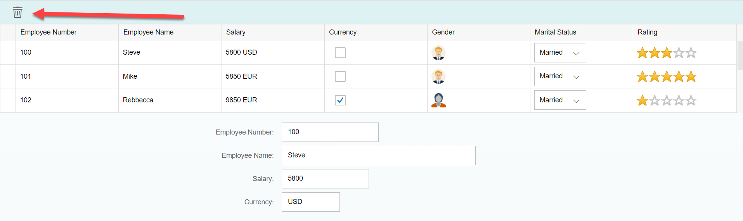
Playing with Models continue…
Example 2:- Delete Row
Now, we will add Delete button on top of the Table, on press of the Delete button the selected row will be deleted form the table and if No row is selected a Message Toast will be shown to select a row.
Flow to perform this task:-
Select a Row
On Selecting a row in the table
Save index value to a global variable
Access the value of index global variable
If it is undefine then show Message Toast
on Press of Delete Button
Yes
Check if the variable is equal to undefined
Set the global variable to undefined
Remove the index from the default model
No

Slide 6

Exercise 2
Now we will perform the Delete row task discussed in Previous Slide
Exercise Code:-
MyXML.view.xml
MyXML.controller.js

Slide 7
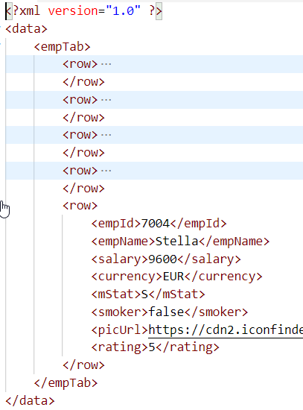
XML Model
The XML model allows to bind controls to XML data. It is a client-side model intended for small datasets, which are completely available on the client. The XML model does not contain mechanisms for server-based paging or loading of deltas. It supports two-way binding.
To instantiate the model, use the following code:
var oModel = new sap.ui.model.xml.XMLModel();
Exercise 3 code link for XML Model:
For code click here

Slide 8
Resource Model
We build software for international audience, we cannot just hardcode every screen element in English, if it requires multi-lingual support, we need to add resource model.
i18n → Internationalization
Create resource bundle which includes label field
The name of the file must be i18n.properties for default labels
And i18n_langcode.properties for different languages
Set The model
For more information about i18n you check the link
https://openui5.hana.ondemand.com/1.34.9/docs/guide/831039835e7c4da3a8a0b49567573afe.html
We can change the language of the app by adding ?sap-language=language_code at the end of the URL of the app. Example for Hindi we will write ?sap-language=hi
Resource Bundle
i18n_de.properties
View
Resource Model
(i18n Model)
i18n_en.properties
…
i18n.properties
(default)

Slide 9
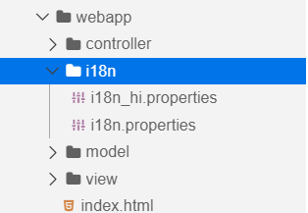
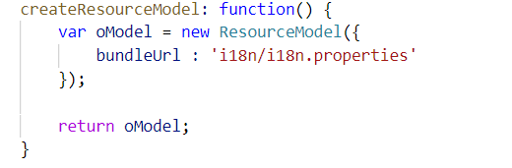
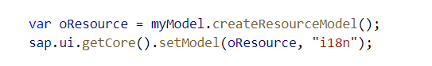
Steps to Create Resource Model
Step 1:- Create a new Folder named i18n and file inside the folder as shown below.
i18n properties for Hindi language
Default i18n properties
Step 2:- Create a function in Model.js file to create a resource model, and set the resource model in the controller.

Slide 10
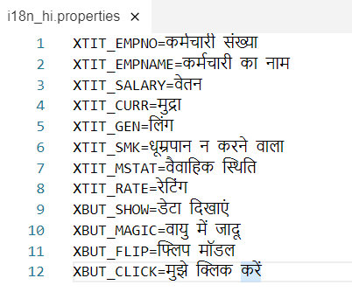
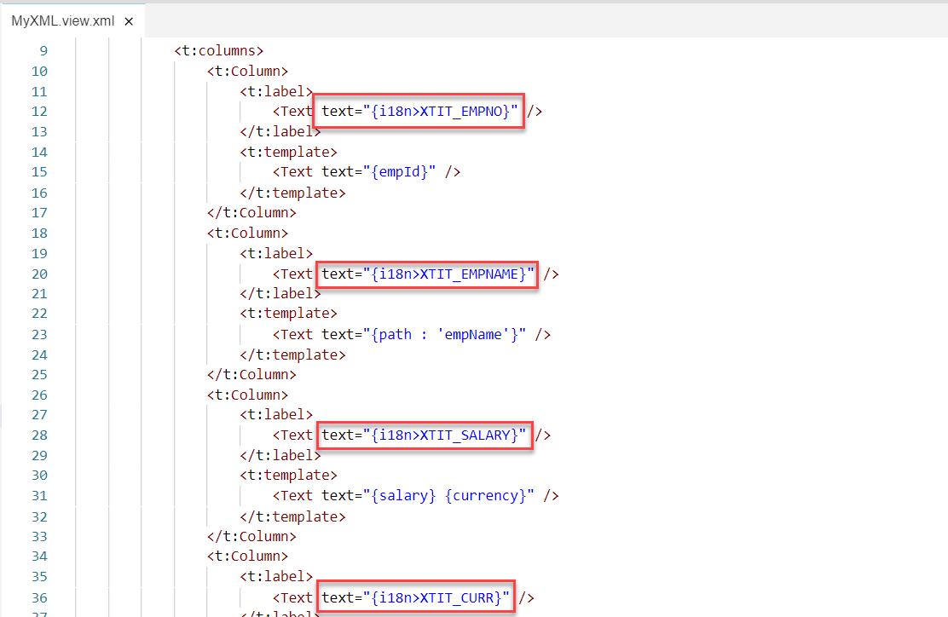
Steps to Create Resource Model continue…
Step 3:- Add the translatable texts in i18n Files.
For English (Default) – i18n.properties For Hindi – i18n_hi.properties
Step 4:- Do the binding in XML view as shown below.

Slide 11
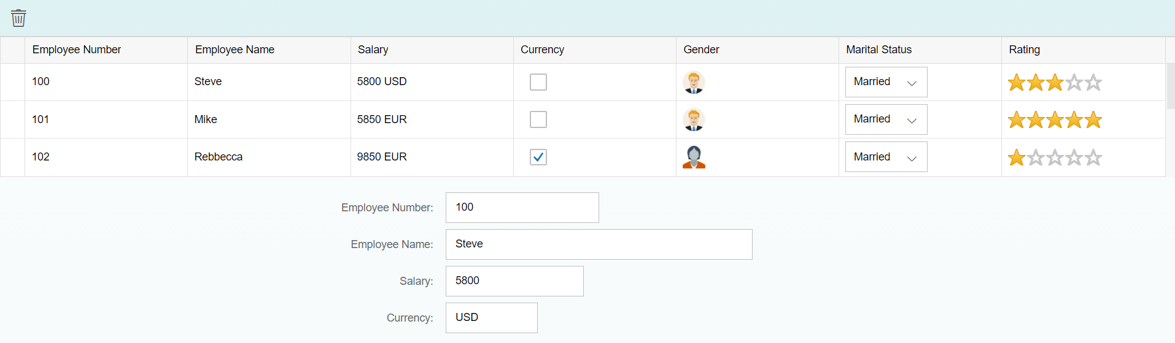
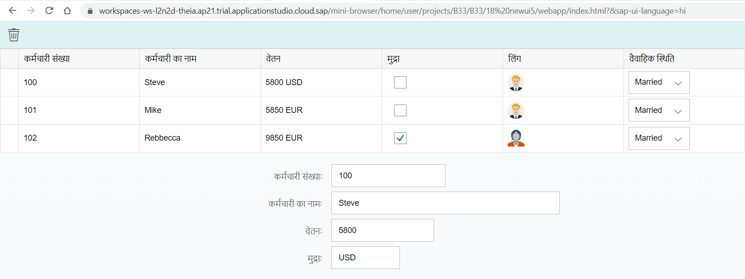
Steps to Create Resource Model continue…
Step 5:- Run the application.
When we run the application initially the default i18n properties will be loaded.
If we want to display the text in Hindi language, then append the text ‘&sap-ui-language=hi’ at the end of URL.
App loaded in English (default i18n.properties)
App loaded in Hindi (i18n_hi.properties)

Slide 12

Exercise 4
In this Exercise we will perform the Steps discussed in the previous slides for creating a Resource Model.
Exercise Code:-
MyXML.view.xml
MyXML.controller.js
i18n.properties
i18n_hi.properties
model.js

Slide 13
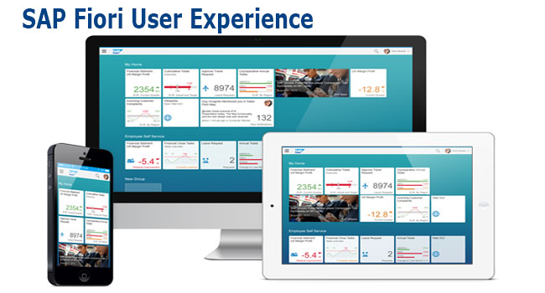
What is Fiori ?
Fiori is SAP’s new user experience. These are standard apps delivered by SAP and by following the Development guidelines any one can use UI5 to create fiori Apps.
Fiori is a streamlined application, delivering a role-based user experience that can be personalized across all lines of business, tasks and devices.
It uses tiles to encapsulate standard tasks like viewing sales orders or approving timesheets.
Fiori = UI5 + Development/Design Guidelines

Slide 14
Structure project
There are different folders and directory are required for setup project: webapp, Controller, models, utils ,view, Component.js, manifest.json, index.html
BaseController
Index.html
(Testing)
Decoupling
Ns,lib,view….
Call Component.js
sap/ui/core/UIComponent
Root view
App.view.xml
App.controller
Component.js
Container Control
App, SplitApp,FlexibleColumnLayout
View 1
Controller
Component container
R
View 2
Controller
manifest.json
Component.js is starting point

Slide 15
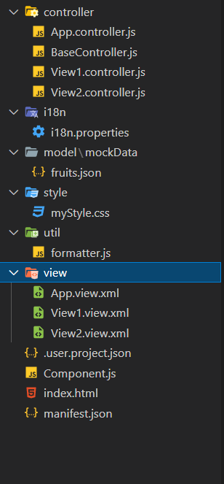
Structure of fiori application setup
There are different folders and directory are required for setup project
Webapp = This provides the root directory and of all files given in alias name or namespace
Controller = The controller folder contains all the controllers used by your views, and might also contain additional logic files that are used by one or more controllers. The structure of the controller folder should mirror the view folder.
models = It contains .json file and object of data
utils = It is the reuse file of JS code
view = It contains all the .xml files.
Component.js = It is the starting file of our app
manifest.json = It is the application descriptor file.
Index.html

Slide 16
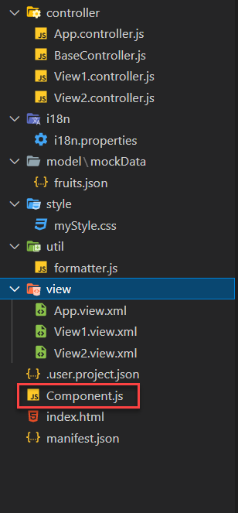
What is Component.js
Component.js the starting point of ANY fiori app. If an app has Component.js inside, its called fiori like app.
The Component.js file is the component controller and provides the runtime metadata and the component methods.
It is the wrapper of all the functionality. We never start any productive code in index.html, rather its all kept in Component.js
It is a class which inherits from sap/ui/core/UIComponent standard class. We inherit to reuse the functionality offered by SAP like routing.
When app starts, UI5 framework will scan your project’s base directory to check if it has a file with exact name Component.js
The component file calls the manifest file and we keep all app level configuration inside the manifest file.
It is also important from the point of view that we will instantiate all models for our application inside the manifest file. The model instantiated in manifest file are directly set on the component and not on the root view.

Slide 17
Skeleton of Component.js
sap.ui.define([
'sap/ui/core/UIComponent'
], function(UIComponent) {
'use strict';
return UIComponent.extend("anubhav.app.Component",{
metadata: {},
init: function(){
},
createContent: function(){
},
destroy: function(){
}
});
});

Slide 18
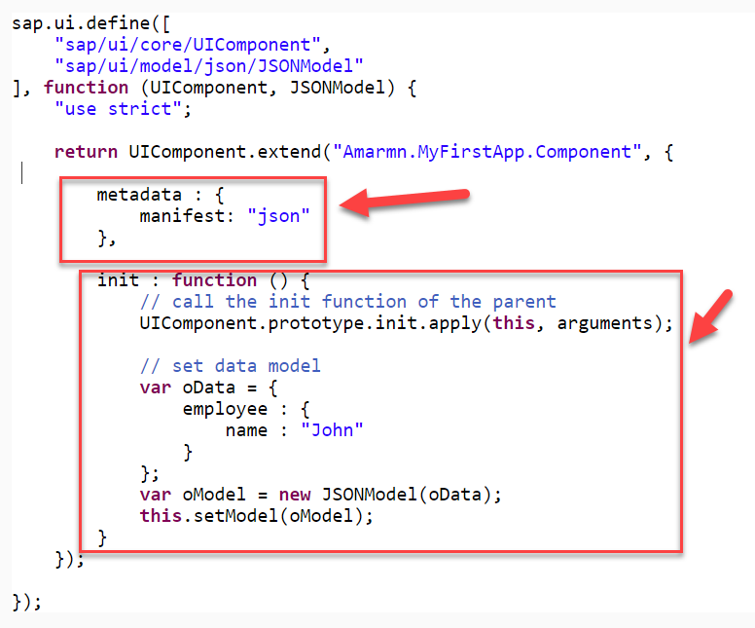
Component.js file has two important parts:
The metadata section. It has property key manifest and value json. This property calls the manifest.json file which is also know as the app descriptor file. It holds all app level configuration and helps keep our Component file clean thereby clearly separating application coding from configuration settings.
Another section of component file is the init function that is called when the component is initialized. When the component is instantiated, the init function is automatically invoked.

Slide 19

Exercise 5
Design simple a Fiori Application
Create a webapp folder
1.1 Create Two folder as controller and view
2. Controller and View section section
2.1 App.controller.js
2.2 BaseController.js
2.3 View1 controller
2.4 View2 Controller
2.5 App.view.xml
2.6 View1.view.xml
2.7 View2.view.xml
3. Component.js
4. index.html

Slide 20

End of Day 9

Slide 21

Any Questions ?

Slide 22

Anubhav Oberoy

Slide 23
Title
Content

